Slide 1

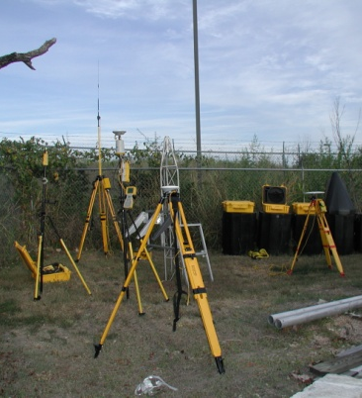
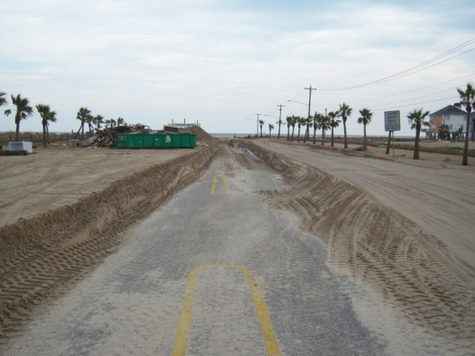
Mapping Hurricane Inland Storm Tides – Documenting the Magnitude and Timing of Hurricane Storm Surge
By Jeffery W. East, Michael J. Turco, Robert Mason Jr. and Charles R. Demas
Notes:
There are many individuals, groups, science centers, and other federal, local, and academic contributors to this effort, you would be hard-pressed to find another more fitting example of teamwork in the USGS and amongst its collaborators and cooperators.

Slide 2
Discussion Points
USGS role in natural disasters
Collecting storm surge data – from deployment to retrieval
Hurricane Rita
Hurricane Ike – Preliminary data
Notes:
USGS plays a “behind the scenes role” before during and after not just hurricanes but also inland floods and other natural disasters. Let me take a couple minutes to discuss our role and mission and how all of this fits together.

Slide 3
USGS Mission
The USGS serves the Nation by providing reliable scientific information to describe and understand the Earth; minimize loss of life and property from natural disasters; manage water, biological, energy, and mineral resources; and enhance and protect our quality of life.
to provide hydrologic information and understanding needed by others to achieve the best use and management of the Nation’s water resources.
Notes:
Many parts but a common goal.

Slide 4
USGS Storm-Tide Program Objectives
Provide data for:
  Development of inundation maps
  Calibration/verification of storm-surge models
  Aide development of model parameterization schemes (inland wind-water drag and -wave height relationships)
  Assess performance of topographical or engineered structures
  (Eventually) real-time assessments and warnings
Notes:
Storm Surge (storm tide) is not well understood. Technology has achieved a level where USGS is confident that some long standing questions on the timing and magnitude of storm surge can no be addressed on a scale previously not attempted. There are many potential uses for this data now, but, the end game is to be able to provide this information in real-time to local emergency managers and planners.

Slide 5
Approach
New technology -small, inexpensive, portable
Mobile network of temporary gages
Reactive, late pre-landfall deployment
Dense network (>40 gages/storm)
Rapid recording intervals
QA against HWMs, post-storm WS elevations
Level-in to datum after storm
Collaborate to build complementary datasets
Notes:
There will be more detail on this late

Slide 6
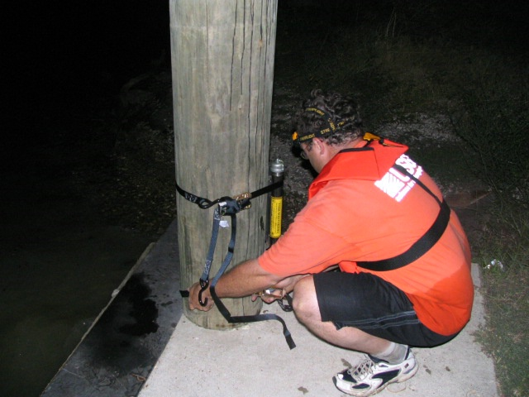
Sensor Deployment
USGS Storm-Tide Response Centers (Ruston, LA., Atlanta, and Orlando) and storm-affected USGS offices
2-person crews
30 to 100+ sites per storm
Deploy 24-36 hours prior to landfall

Slide 7
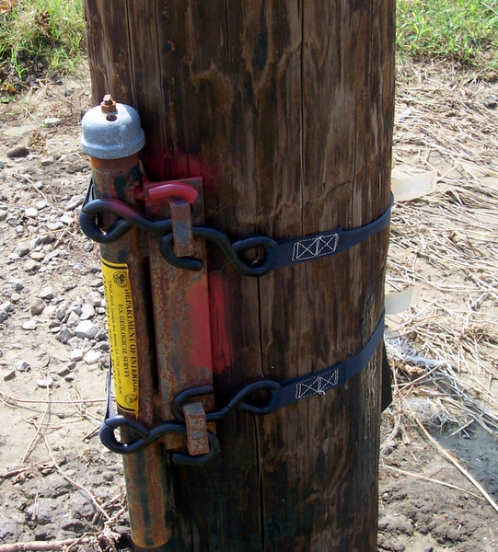
Sensor Deployment
Strap-on sensors, mark Ref Pts, take pictures, get GPS coordinates
Check-in each hour
“Clear out” at 12 hours to landfall
Time in field storm dependent

Slide 8
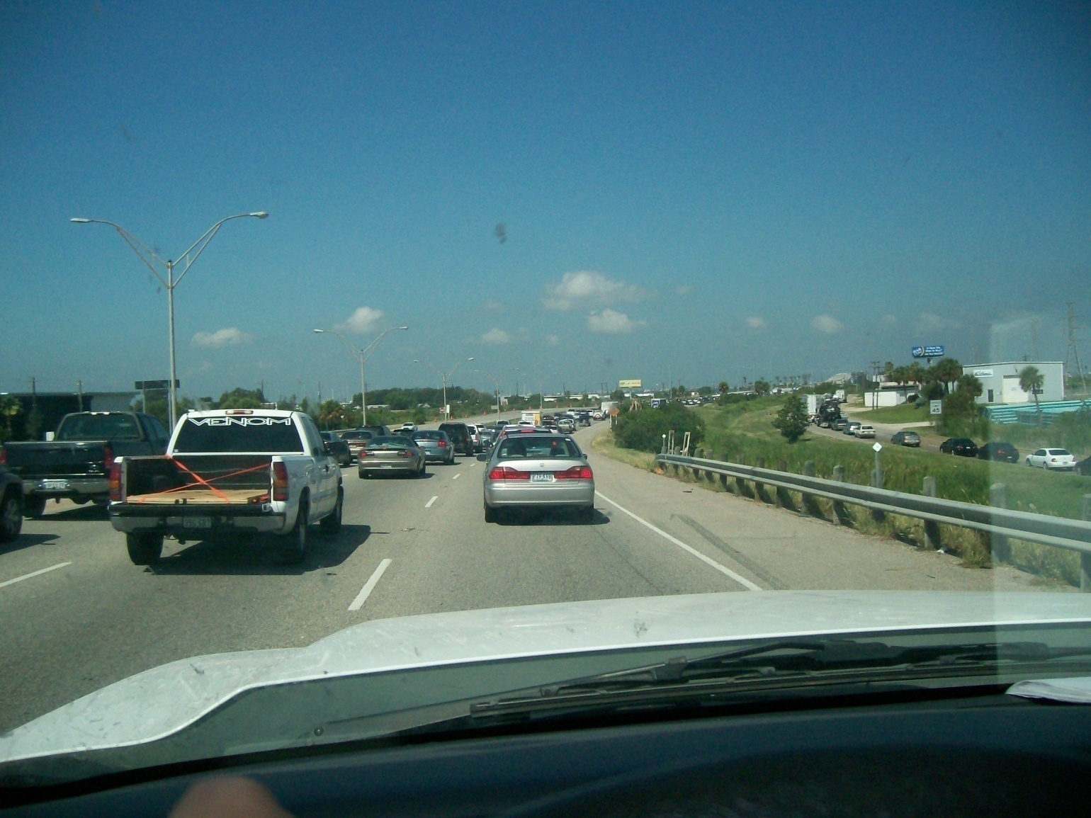
Sensor Deployment

Slide 9
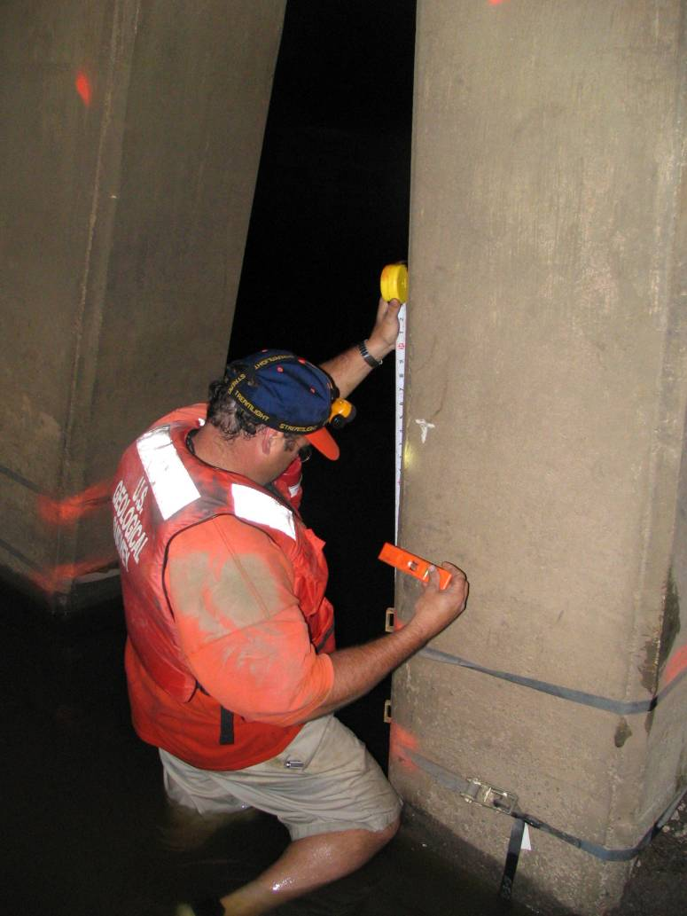
Sensor Recovery
Retrieve sensors, flag HWMs, tape-down to H₂O, run local levels Download, adjust data for barometric pressure, salinity, and upload to web
Follow-on GPS crews determine local datum

Slide 10
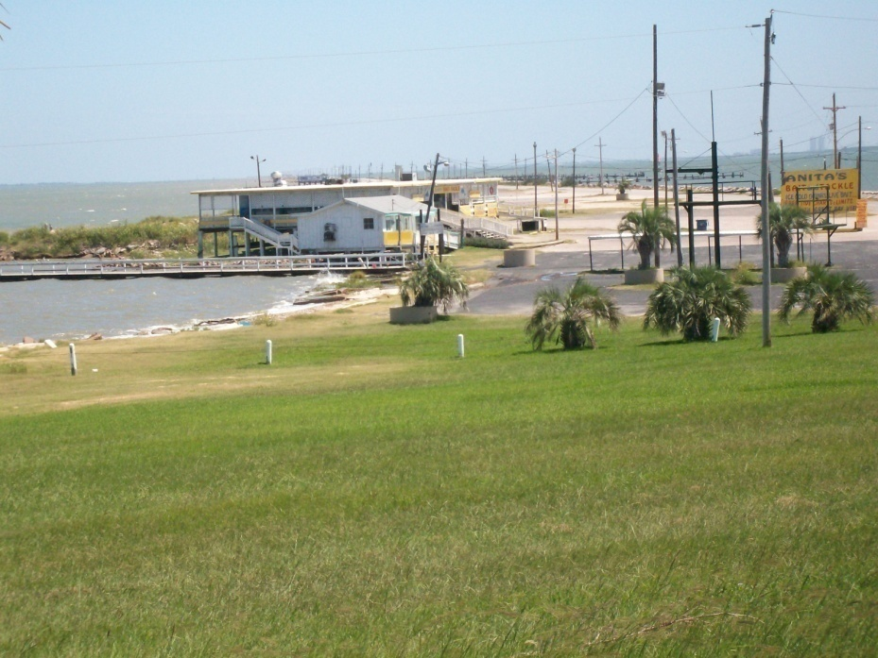
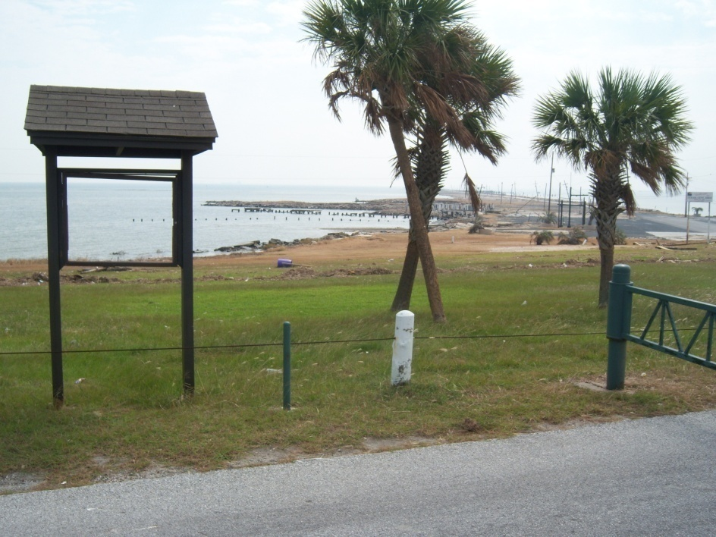
Texas City Dike
Deployment
Recovery

Slide 11
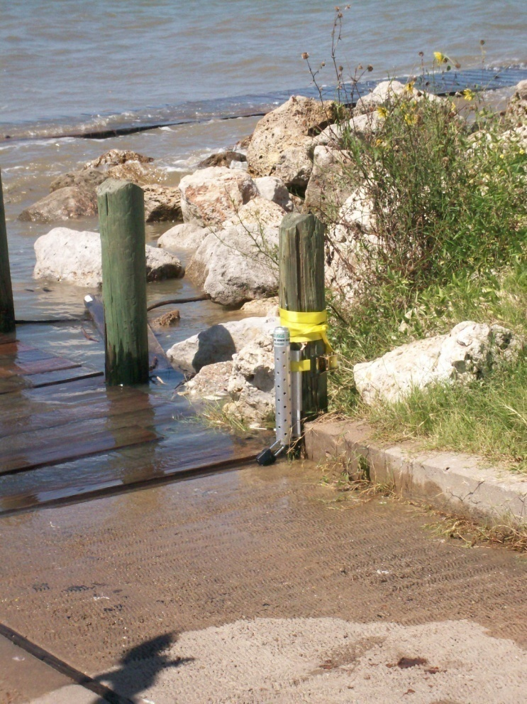
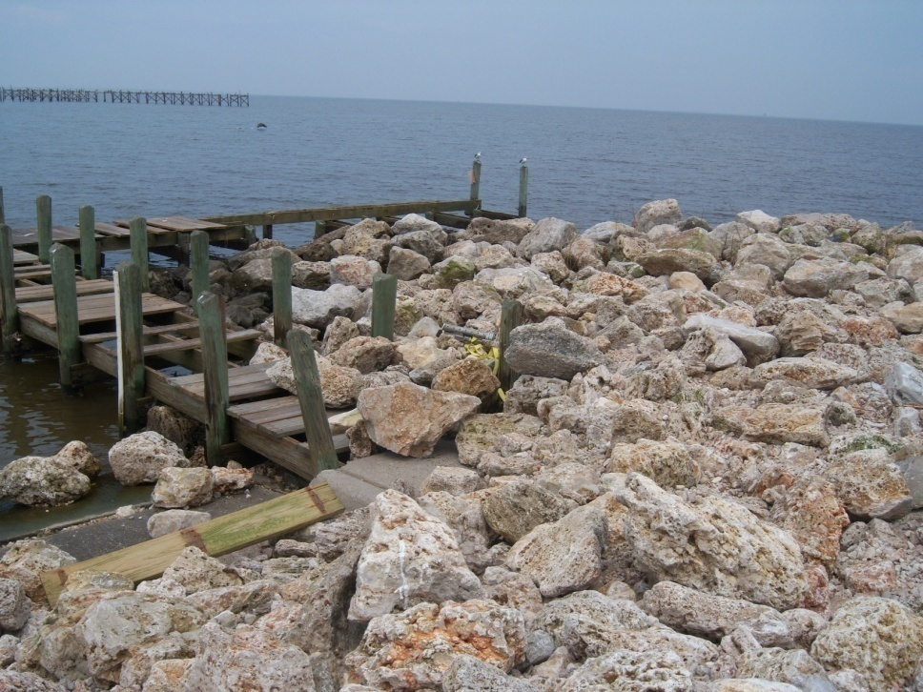
Seabrook
Recovery
Deployment

Slide 12
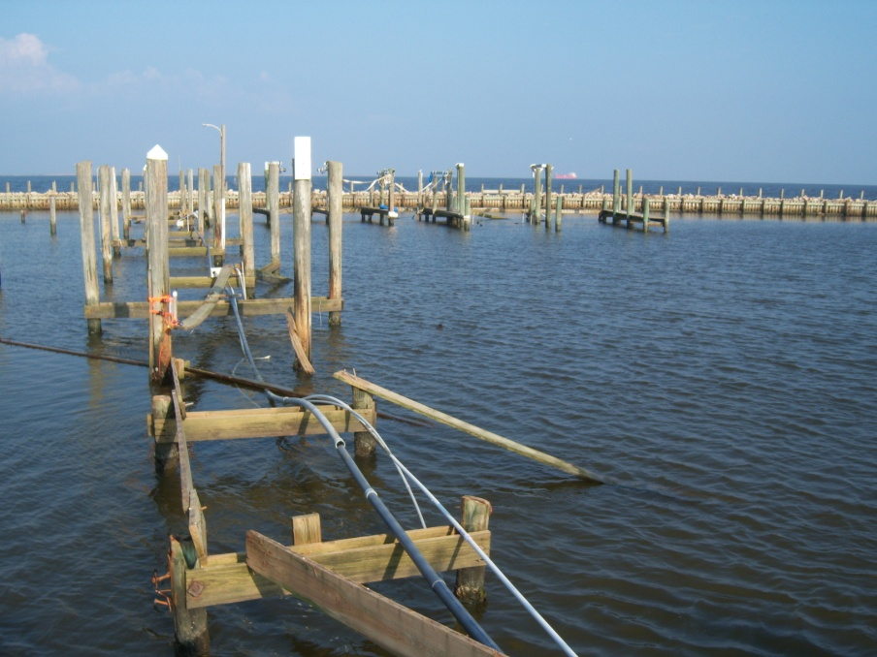

Houston Yacht Club
Surfside Beach

Slide 13

Establishing Datum Across Network
Corrected data adjusted to elevation using GPS survey systems, differential levels, and graduated tapes
As, if not more, labor intensive than deployment
Notes:
Apples to apples in parammount when trying to develop a timing scenario for the surge. Many benchmarks are available along the coast for this type of work, however the quality and stability of these marks can be suspect. Establishing benchmarks at each of the surge sites is the most appropriate way buy which to insure that we are comparing apples-apples

Slide 14
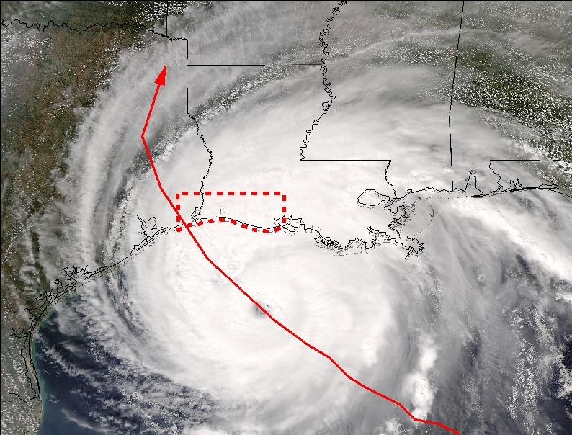
First Deployment -Hurricane Rita
Study area positioned east of the hurricane track
Covered approx. 4,000 square miles
Extended approx. 30 miles inland and 140 miles along the coast
Site selection emphasized road access
Target bridges and piers near waterways
Supplement with “transects” when possible
ARKANSAS
MISSISSIPPI
LOUISIANA
TEXAS
Study Area
N
Gulf of Mexico
Storm Path
Notes:
Hurricane Rita, 2005

Slide 15
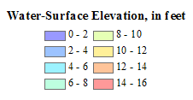
Maximum Storm Tide Hurricane Rita (2005)

Slide 16
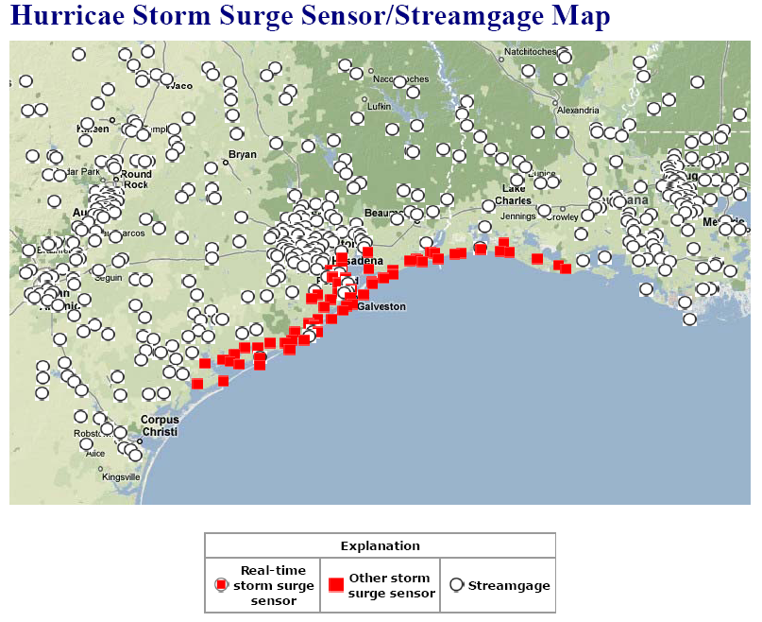
Hurricane Ike (2008) Deployment Area
Hurricane Ike Storm Surge Sensor/Streamgage Map
Notes:
Ike deployment area covers about 300 miles of coast line. Didn’t plan it that way, but that is the way it worked out. Check out the nest slide.

Slide 17
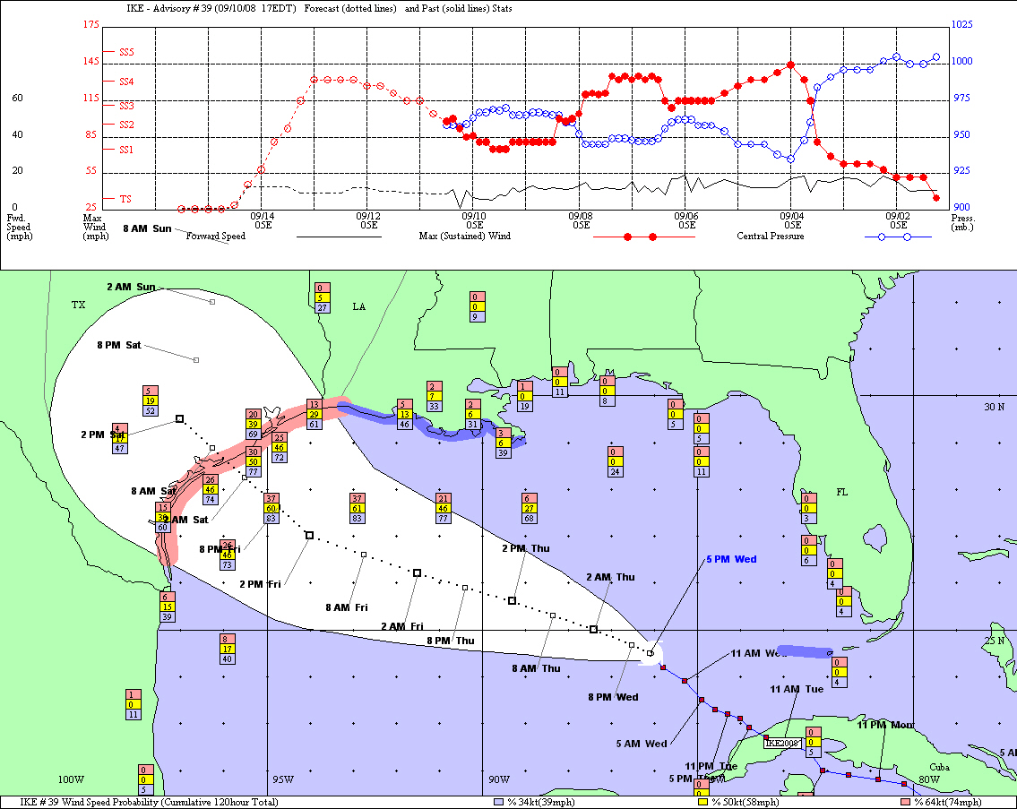
Initial Deployment Area
Notes:
September 10th Estimated area of effected coastline – when all of texas is probable, there will be some memorized windshields. Considering deployment, one has to account for the mandatory evacuations, traffic (think houston during rita), and other ancillary factors outside of our control when formulating the deployment strategy.

Slide 18
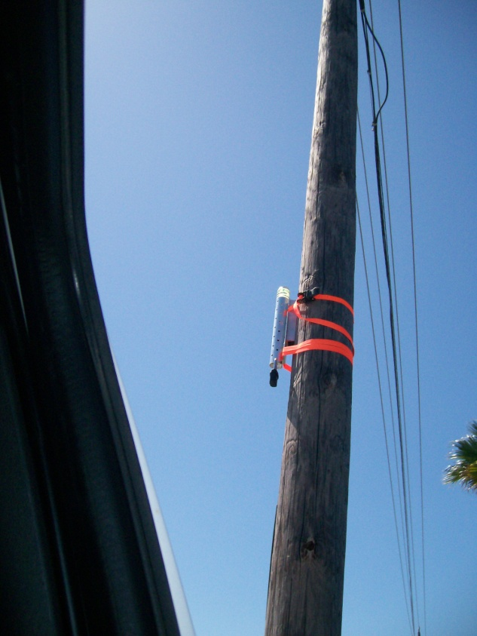

Field Deployment – Hurricane Ike (2008)
Prior to 2008 Hurricane season, possible deployment locations chosen
Recon
Sensors synched and turn-on time set just prior to deployment
1 minute interval
2 sensors per site
Two sensors are used at each site to account for the effects of changing barometric pressure on the non-vented sensors
Bay shore boat ramp (Seabrook)
Notes:
Some examples

Slide 19
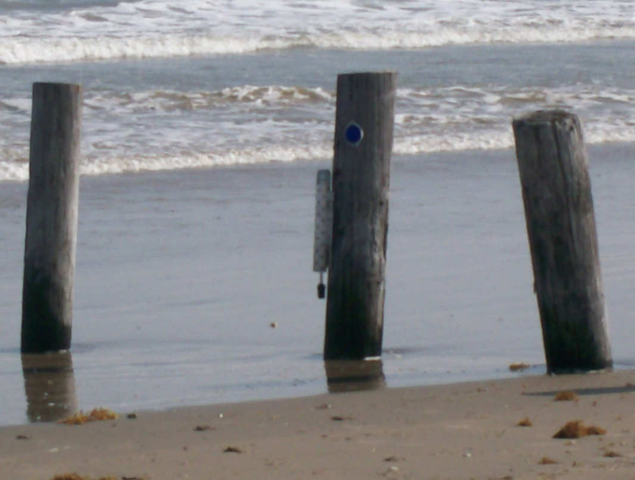
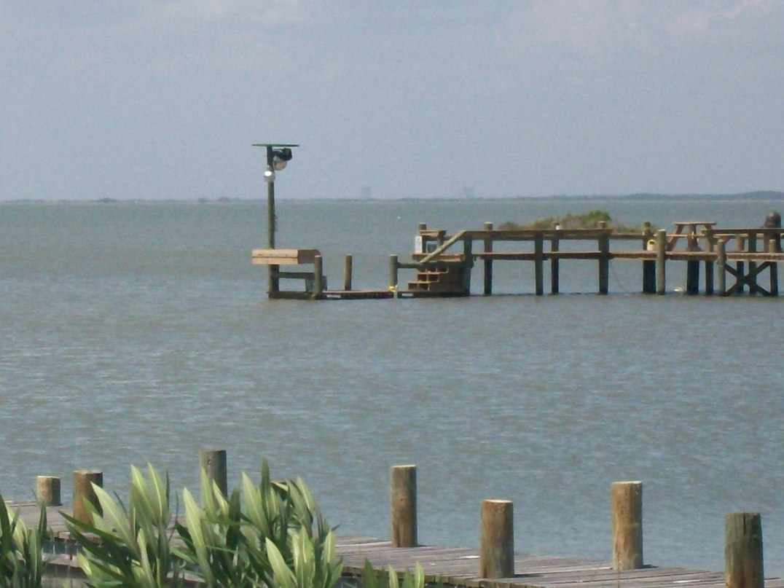
Field Deployment – Hurricane Ike (2008)
Surfside Beach and Tiki Island

Slide 20
Preliminary Data
Post-assessment of Hurricane Ike on-going
Storm surge data from the placed sensors not currently available for release
However…
  USGS, in cooperation with several state, county, city, and federal agencies operate streamflow and stage gages in the impact area.

Slide 21
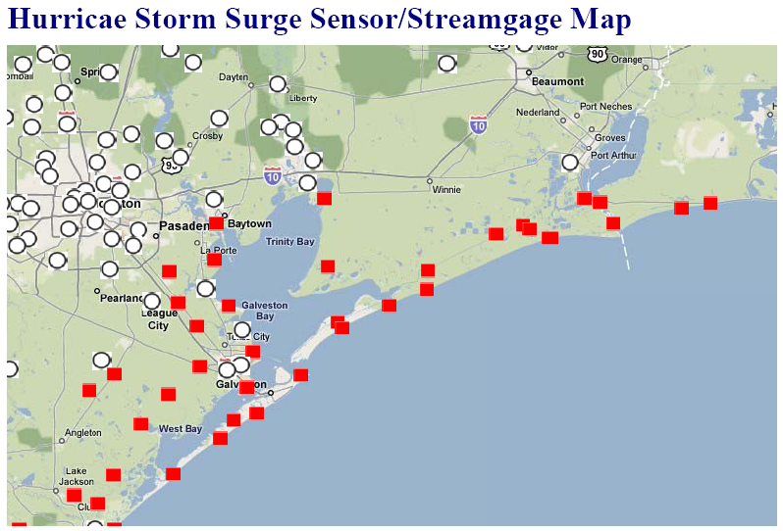
Hurricane Ike (2008) primary focus area
Hurricane Ike Storm Surge Sensor/Streamgage Map
Notes:
Circled areas will be discussed in following slides

Slide 22
Real-time gages in Hurricane Ike landfall area
Notes:
Composite, notice range in delta y during landfall.

Slide 23
Hurricane Ike (2008) primary focus area
Hurricane Ike Storm Surge Sensor/Streamgage Map
Notes:
Circled areas will be discussed in following slides

Slide 24
Freeport Area Preliminary Storm Surge Max ~ 6 feet
Notes:
South west of land fall area

Slide 25
Hurricane Ike (2008) primary focus area
Hurricane Ike Storm Surge Sensor/Streamgage Map
Notes:
Circled areas will be discussed in following slides

Slide 26
Western Galveston Bay Preliminary Storm Tide Max ~ 8-10 feet
Moses Lake
Clear Lake
Notes:
Western Galveston Bay Area – max about 8-10 feet. Note that cvlear lake and moses lake saw a drop in elevation when la marque was showing a peak, truns out that when you compare this to the wind data at those two sites the wind died down to essentially nothing (possibly the eye of the storm passed over these two gages).

Slide 27
Eye passes Clear Lake

Slide 28
Hurricane Ike (2008) primary focus area
Hurricane Ike Storm Surge Sensor/Streamgage Map
Notes:
Circled areas will be discussed in following slides

Slide 29
Houston Turning Basin Preliminary Storm Tide Max ~ 10-12 feet
Notes:
Northern Galveston Bay – Trinity Bay area – about 10-12 feet max

Slide 30
Hurricane Ike (2008) primary focus area
Hurricane Ike Storm Surge Sensor/Streamgage Map
Notes:
Circled areas will be discussed in following slides

Slide 31
Trinity River nr Wallisville Preliminary Storm Tide
Max ~ 14 ft

Slide 32
Hurricane Ike (2008) primary focus area
Hurricane Ike Storm Surge Sensor/Streamgage Map
Notes:
Circled areas will be discussed in following slides

Slide 33
Port Arthur Area Provisional Storm Tide Max ~12 feet
Notes:
Part Arthur is east of the land fall area and was in that “dirty” part of Ike. The graph shows only one of the sensors, the maximum at the site field verfied through a seed line within the gage is a little over 14 feet above the gage datum (in this case is sea level)

Slide 34
Hurricane Ike (2008) primary focus area
Hurricane Ike Storm Surge Sensor/Streamgage Map
Notes:
Circled areas will be discussed in following slides

Slide 35
Neches River – Beaumont, TX
Notes:
This is stream velocity where negative values mean direction is up stream. At this velocity at this site the discharge UP the neches river was about 30,000 cfs.

Slide 36
Neches River – Beaumont, TX

Slide 37
Rate of change in stage up to ~ 1.0/15 minutes
Notes:
This is very busy but is an attempt to show the first dirivitave of the surge/stage data. The rate of change at wallisville (trinity bay) was much higher than at moses lake (western side of galveston bay.

Slide 38
Hurricane Ike (2008) primary focus area
Hurricane Ike Storm Surge Sensor/Streamgage Map
Notes:
Circled areas will be discussed in following slides

Slide 39
Storm Surge Sensor – Crystal Beach

Slide 40
Hurricane Ike (2008) primary focus area
Hurricane Ike Storm Surge Sensor/Streamgage Map
~14 ft.
~10-12 ft.
~8-10 ft.
~6 ft.

Slide 41
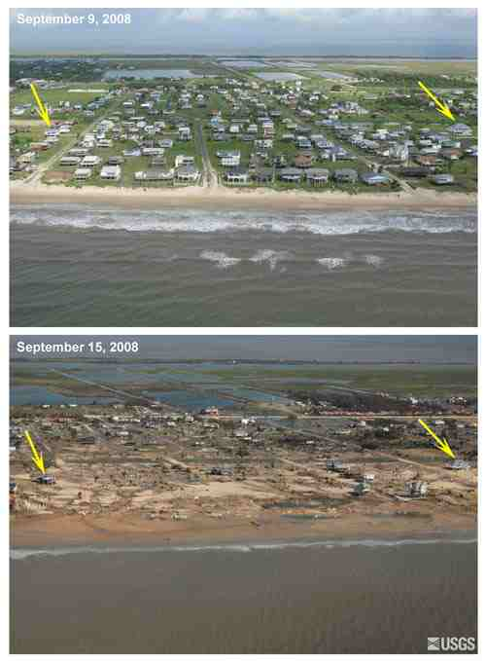
http://coastal.er.usgs.gov/hurricanes/ike/photo-comparisons/bolivar.html

Slide 42
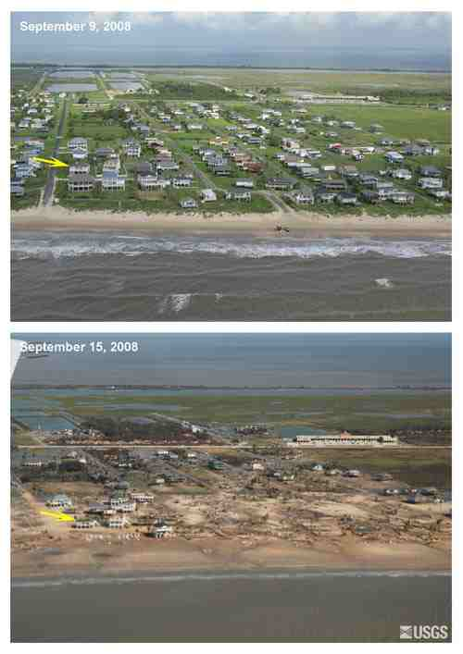
http://coastal.er.usgs.gov/hurricanes/ike/photo-comparisons/bolivar.html

Slide 43
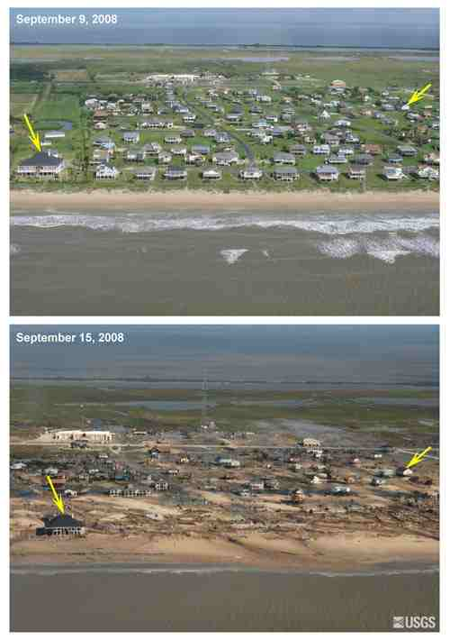
http://coastal.er.usgs.gov/hurricanes/ike/photo-comparisons/bolivar.html

Slide 44
Summary
This storm surge effort provides useful information to fill in the gaps between permanent gaging stations
Hurricane deployments for Gustav and Ike are in post assessment stage
Preliminary storm tide values range from 6-14 feet along the Texas Coast
Expect publication of data by end of November

Slide 45
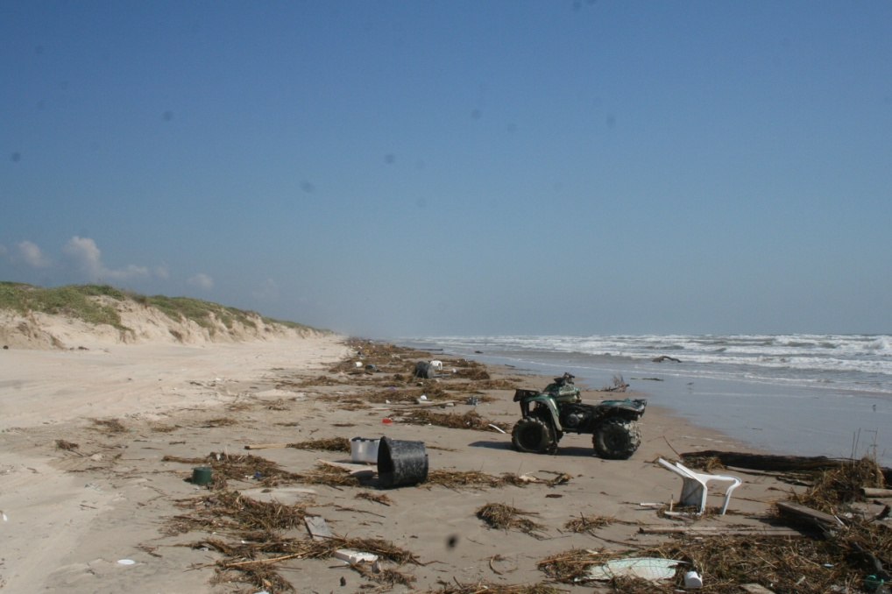
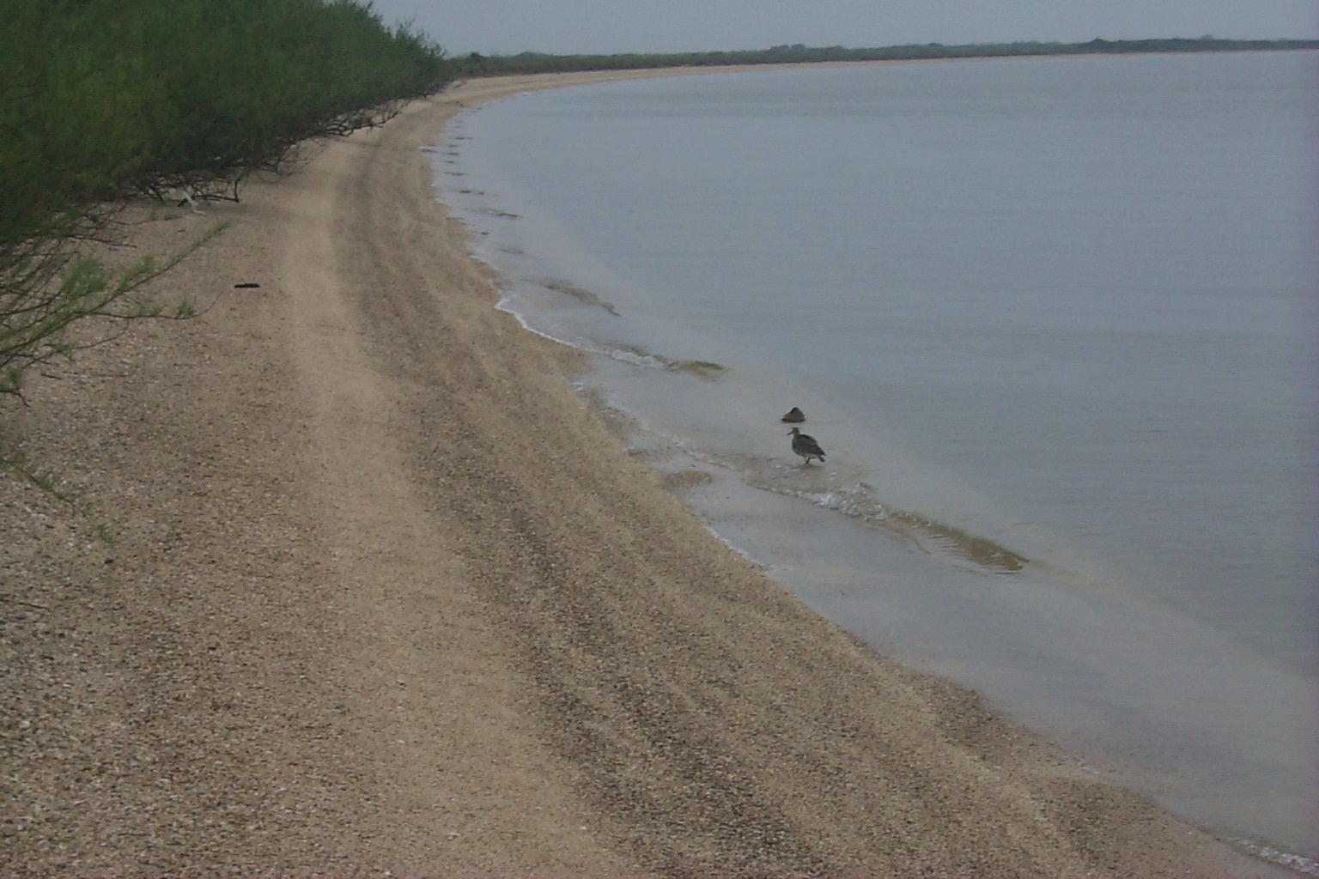
Contact Information
Jeff East, jweast@usgs.gov
USGS Texas Water Science Center
Gulf Coast Program Office
19241 David Memorial Drive, Suite 180
Conroe, TX, 77385
Notes:
Top picture is from Padre Island, near corpus, the debris is remnant from Ike.

